Slide 1
Employee Data Analysis using Excel
STUDENT NAME :P.PAVATHARANI
REGISTER NO :312208978
NM ID :71C51A4759C90DCA91E408809FDFCDAC
DEPARTMENT :B.COM( GENERAL)
COLLEGE : CHEVALIER T.THOMAS ELIZABETH COLLEGE FOR WOMEN

Slide 2
PROJECT TITLE
EMPLOYEE TURNOVER ANALYSIS USING PIVOT TABLE

Slide 3


AGENDA
Problem Statement
Project Overview
End Users
Our Solution and Proposition
Dataset Description
Modelling Approach
Results and Discussion
Conclusion
3/21/2024 Annual Review

Slide 4

PROBLEM STATEMENT
An employee turnover analysis problem statement might look something like this:Problem Statement:"Our organization is experiencing a high rate of employee turnover, with [X]% of employees leaving the company within the past [X] months/years. This is resulting in significant costs associated with recruiting, training, and replacing departed employees, as well as potential losses in productivity, knowledge, and expertise. We need to identify the underlying causes of this trend and develop effective strategies to reduce turnover, improve employee retention, and maintain a stable and skilled workforce."

Slide 5

PROJECT OVERVIEW
The project involves analyzing employee data using Excel which helps in gaining the knowledge regarding organizational data, turnover analysis by creating visualizations to understand the turnover rate in organization.
Analyze the current employee turnover trends and identify the underlying causes- Develop effective strategies to reduce turnover, improve employee retention, and enhance overall employee experience- Implement recommendations and monitor progress to ensure a stable and skilled workforce

Slide 6

WHO ARE THE END USERS?
1.HR Department: HR teams will use the analysis to identify trends, develop targeted retention strategies, and evaluate the effectiveness of HR initiatives.
2. Management Team: Managers will utilize the insights to understand the reasons behind turnover, identify areas for improvement, and develop strategies to retain key talent.
3. Senior Leadership: Executive leaders will use the analysis to understand the organization's turnover trends, assess the impact on business objectives, and allocate resources to address retention challenges.
4. Department Heads: Department heads will use the analysis to identify turnover trends specific to their teams, develop targeted retention strategies, and allocate resources to address department-specific challenges.
5. Line Managers: Line managers will use the insights to understand the reasons behind turnover, identify areas for improvement, and develop strategies to retain key team members.

Slide 7

OUR SOLUTION AND ITS VALUE PROPOSITION
Filtering- purpose to fill the missing values.
*Conditional formatting- blank values.
*Usage- Pivot table and data chart.
Formulas-Employee left,total employees and turnover rate.

Slide 8
Dataset Description
Employee data set- Kaggle
There are 26 features
The important ten features are,
Employment ID
First name
Last name
Gender
Employee status
Employee type
Employee classification

Slide 9

THE "WOW" IN OUR SOLUTION
TURNOVER ANALYSIS- These include the categories such as ACTIVE,VOLUNTARILY TREMINATED,LEAVE OF ABSENCE,TERMINATION FOR CAUSE.
Using Pivot table and charts for analysing the turnover
3/21/2024 Annual Review
9

Slide 10
MODELLING
The modelling in this employee performance analysis project includes the following:
*Data collection
*Data cleaning
*Techniques
*Results
*Pivot table
*Chart graphs
10

Slide 11
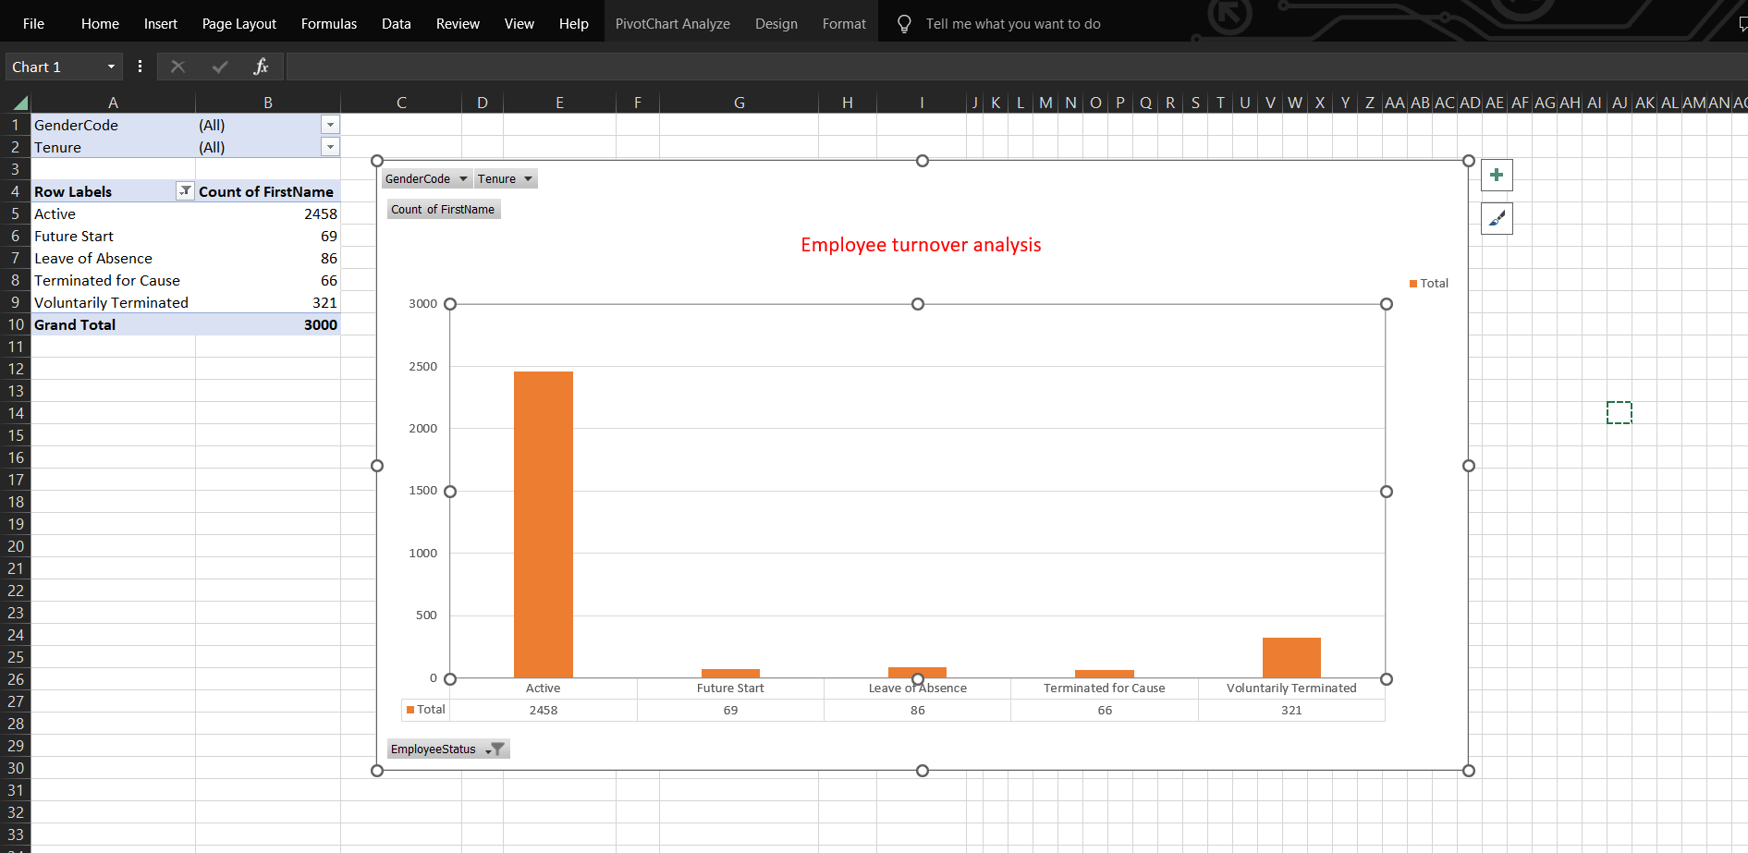
RESULTS
11

Slide 12
conclusion
Improving employee development and growth opportunities
Enhancing management training and coaching
Promoting work-life balance and employee well-being By addressing these areas, the organization can reduce turnover, improve employee retention, and enhance overall employee experience.
The recommended strategies and initiatives outlined in this report aim to achieve these objectives.
Key Recommendations:
Develop and implement a comprehensive employee development program
Provide regular management training and coaching
Introduce flexible work arrangements and employee wellness initiatives

